Slide 1
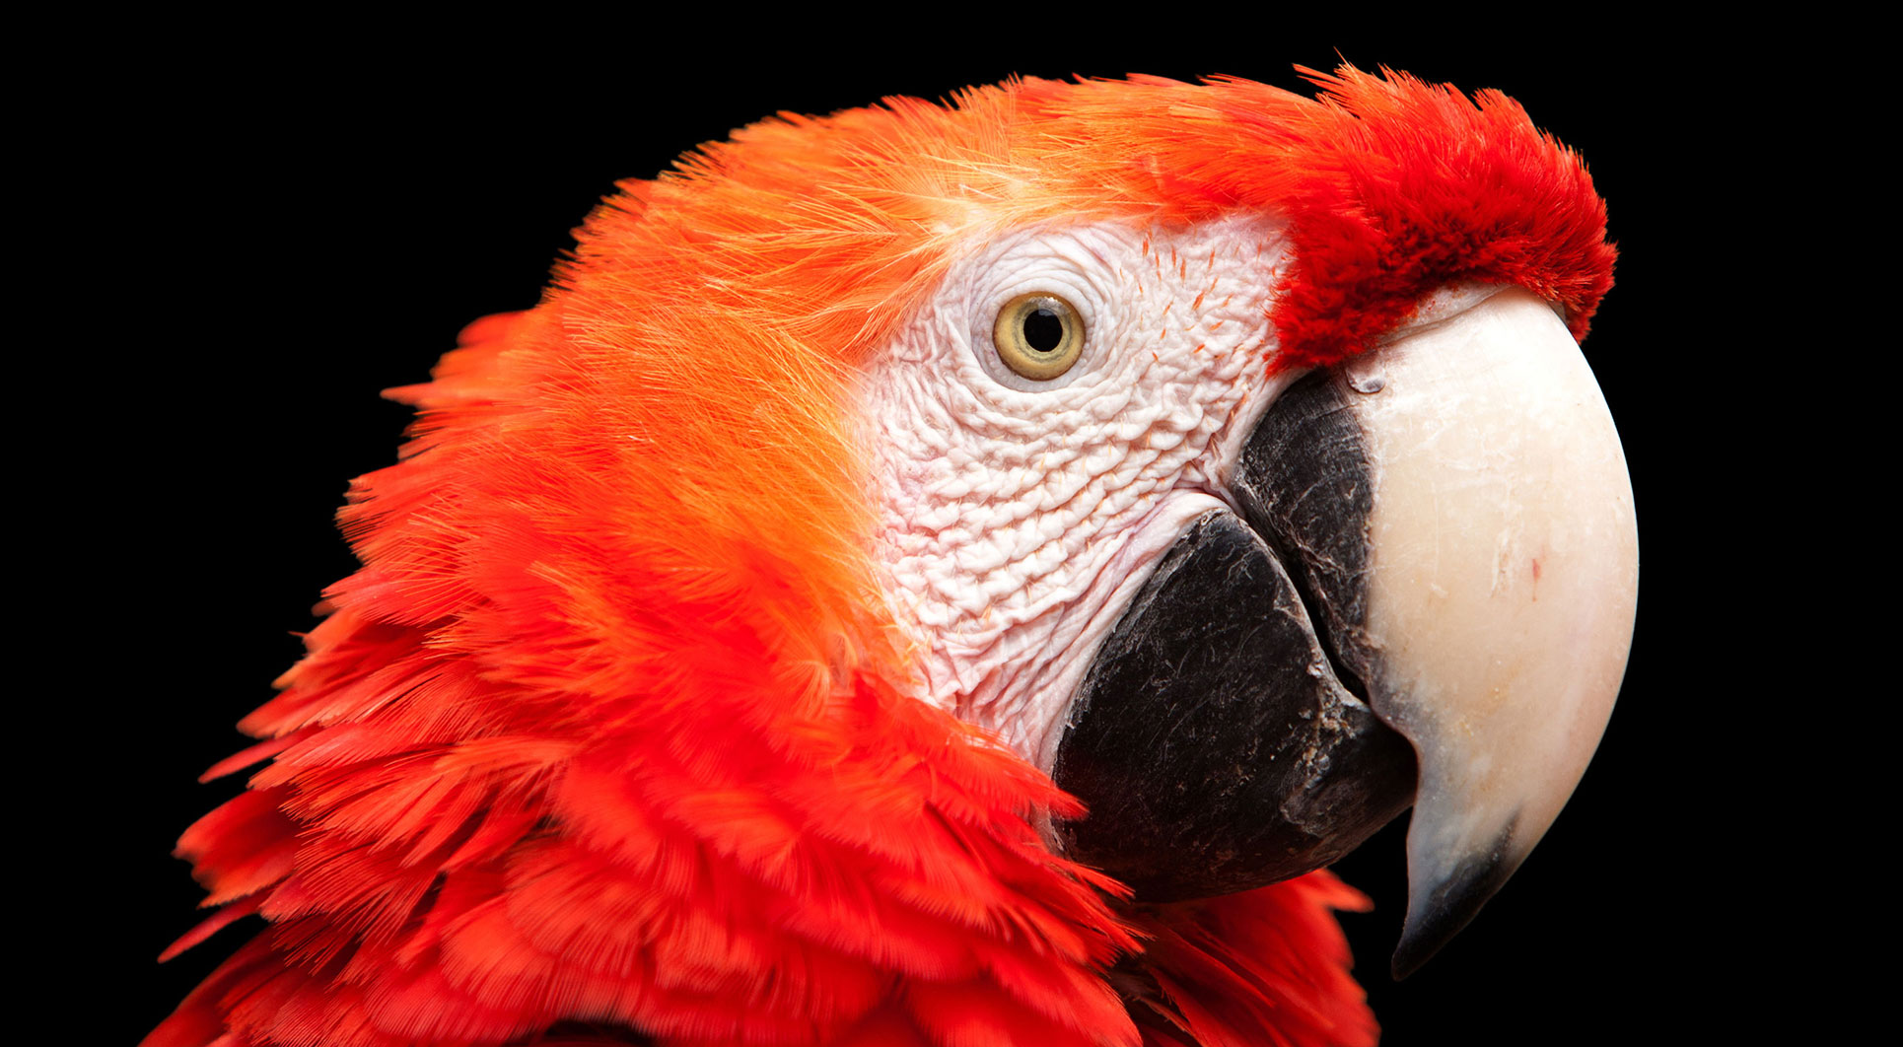
Link prediction in Graph
Advanced AI for Data Analytics
AA4 - Ghassen Abdedayem

Slide 2
Table of contents
Introduction
Data processing
Model
Possible improvements

Slide 3

Introduction
Goal of the project and Data description

Slide 4
Goal of the project
Given a papers citations graph along with the authors and abstract of each paper, we need to predict if there is a link between a new pair of nodes (papers).

Slide 5
Data characteristics

Slide 6

Data processing
Feature engineering

Slide 7
Data processing
edge_list.txt
authors.txt
edge_list.txt
abstracts.txt
edge_list.txt

Slide 8
Adjacency matrix

Slide 9
Random walks
Struct2vec

Slide 10
Text embeddings

Slide 11
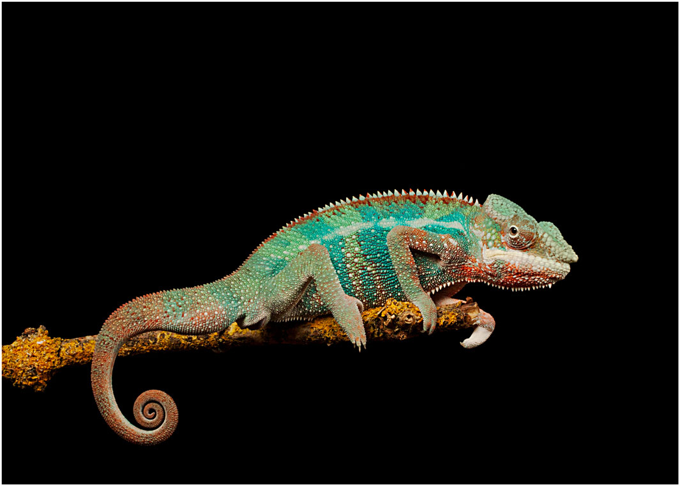
Model
Goal of the project and Data specificities

Slide 12
Possible improvements
Goal of the project and Data specificities

Slide 13
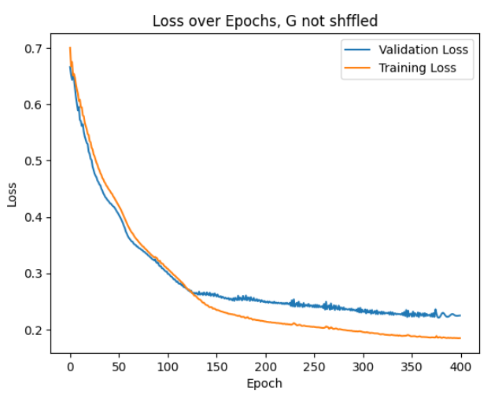
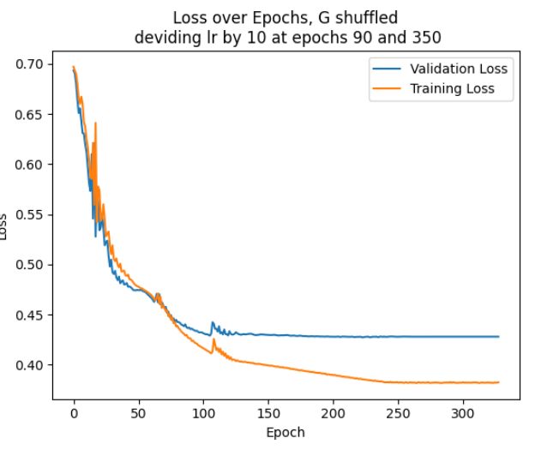

Slide 14
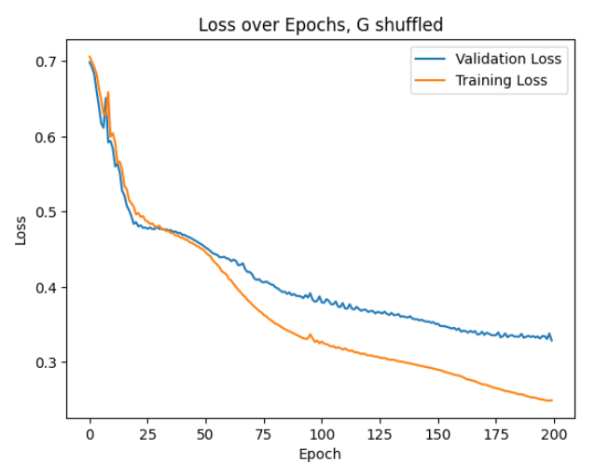
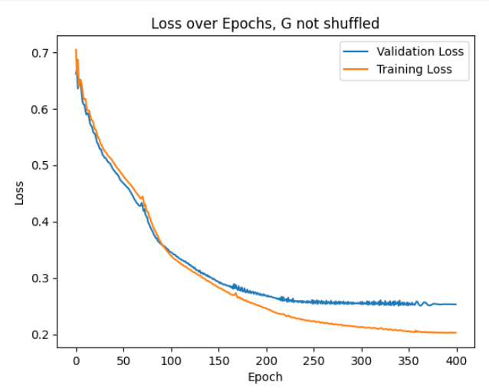
Sparse authors

Slide 15
Normalize adj

Slide 16
Data processing

